Slide 1
Student Knowledge System
Team Hive
Aum Palande, Nishant Basu, Mukil Senthilkumar, Raunak Kharbanda, Prakhar Suryavansh, Ellika Mishra, Susheel Vadakkekuruppath

Slide 2
Overview
Helps professors learn current student’s name
Quiz for guessing a name given an image
Helps professor remember previous students
Professors can add notes or tags about students
Professor uploads data from Howdy
Upload whole courses from Howdy
Upload individual students
Allows the professor to upload each section and course
Legacy Project
Notes:
Legacy project, so our focus was on adding, cleaning, and fixing features that may or may not already be partially implemented

Slide 3
Users and Use Cases
Professors trying to learn current students
Professors trying to remember previous students
TA positions
Letters of Recommendation
Professors trying to see when students took their course

Slide 4
Sprint Changes and Design Changes
Sprint 1
UI changes
Understanding of code base and local setups
Cleaning of previous system
Sprint 2
Updating system for new Howdy system
CRUD operations for Courses/Students
Sprint 3
Quiz changes and bugs
Refactoring
Sprint 4
Future-proofing
Bug fixing
Design Principle:
Functionality over visuals
Make system easy to use for any professor, not just computer science
Allow for as many operations as possible
Not cluttered, but still very functional
Notes:
Sprint 1:
changes on explanation of login page, create new student page (updated major and classification to pick from data to eliminate inconsistencies)
Understand how probject and deployment is setup, had issues with local setups so we updated documentation
Had failing test cases so we fixed those and made sure that anyother test cases were handled correctly
Sprint 2:
New howdy data which meant changing how the upload page looked (and the instructions on it), then changing the backend-script to match the new data. Old data had images exported but the new howdy doesn’t do that, so we scraped base64 images from html of the images.
Added crud, specifically delete and update for courses, students, and made notes/tags about the student
Sprint 3:
Fixed quizzing, allowed for specific sections, and added metrics for how many right, how many left ….
Refactoring upload script to work cleaned and handle more edge cases
Uploading student with ‘ in name
Sprint 4:
Fixed bugs with specific section
Rubocop and code coverage

Slide 5
Challenge and Lessons
Challenges
Limited data to test on due to FERPA
Outdated documentation for setup
Underestimation of task times
Lessons
Start earlier
Talk out loud and pair code more
“Functionality over visuals” is more important and respected than other principles
Managing data, and don’t create future bugs for yourself
Notes:
Last slide

Slide 6
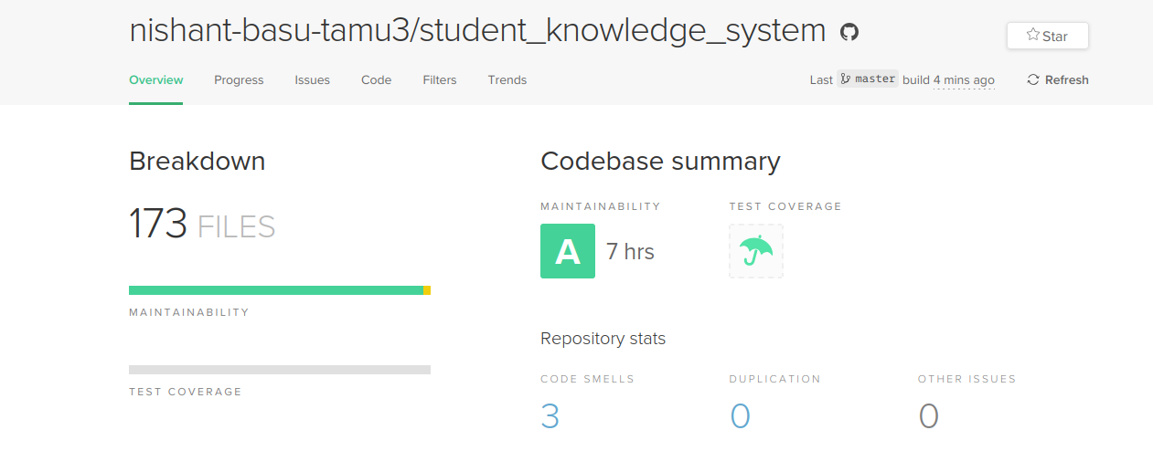
Code Climate

Slide 7


Test Coverage
Coverage increased from to 88.24.

